Slide 1
WPF Validation

Slide 2
Agenda
Binding Validation
Validation Rule
Error Template
IDataErrorInfo
Enterprise Library 4
Custom Markup Extension

Slide 3
If you know all this… then feel free to leave
How to do binding validation with:
Validation Rules
Exceptions
IDataErrorInfo
Validation Application Block
Markup Extensions

Slide 4
Rules for being an Invitee
Name is required
Age has to be greater than 18
Must have a valid email address

Slide 5
Using Validation Rules

Slide 6

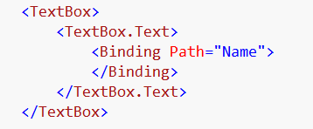
Binding – Markup Extension
Normally you see binding as
but that is just a binding markup extension.
We can also set a binding like this

Slide 7
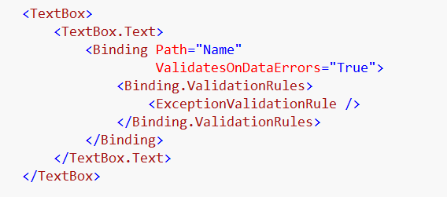
Add Validation Rules to Binding
Binding needs to Validate on Data Error
Allows to the setting of Validation Rules to Binding

Slide 8
What Validation Rules come with WPF
DataErrorValidationRule
ExceptionValidationRule

Slide 9
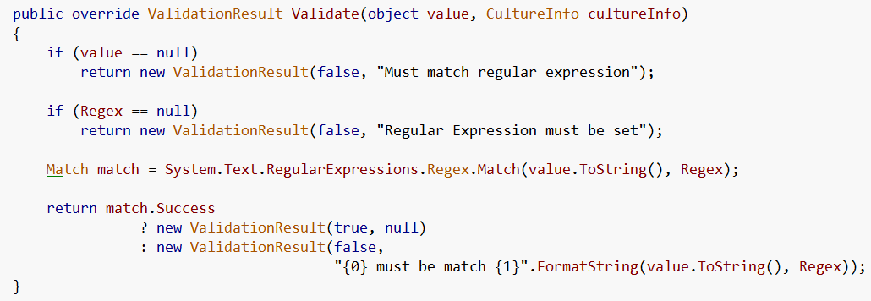
How can I make my own Validation Rule
Just inherit from Validation Rule
And override Validate…

Slide 10
Implement Validate and return ValidationResult
Fail
Pass

Slide 11
Displaying the Errors

Slide 12
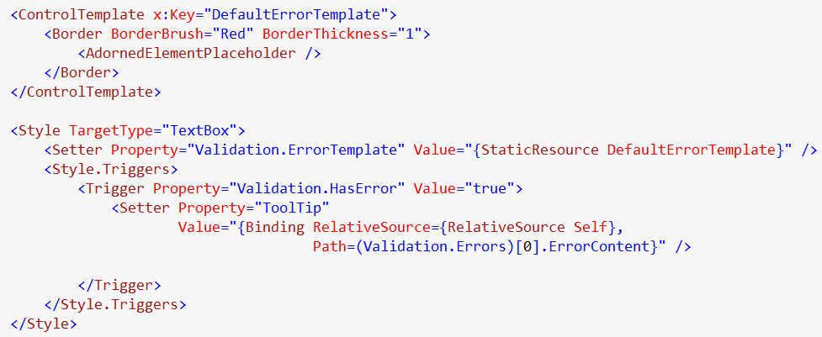
Displaying Error using a Style and Template

Slide 13
Using Exceptions

Slide 14
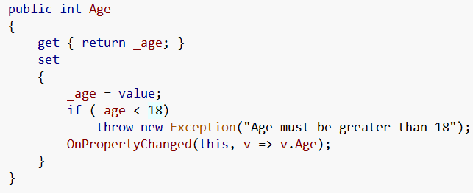
On source…
Throw exception
Exception message will be the error content

Slide 15
On binding…
Set ValidatesOnExceptions

Slide 16
Using IDataErrorinfo

Slide 17

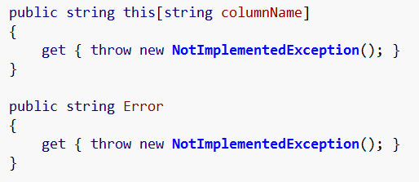
Implements

Slide 18
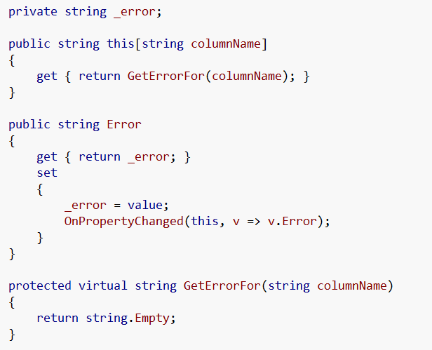
On base ViewModel

Slide 19
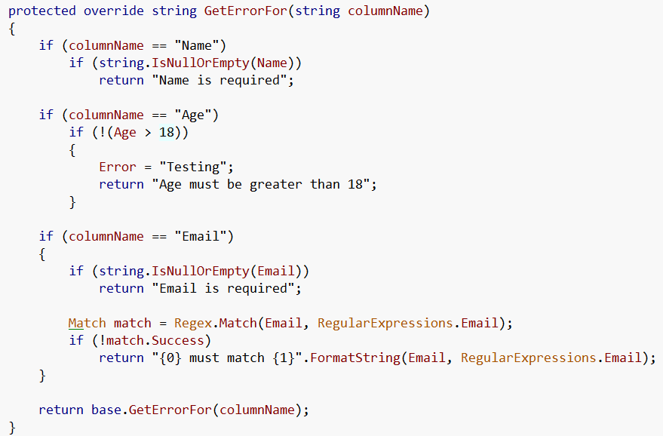
On Party Invitee View Model

Slide 20
On Binding
Validates On Data Errors

Slide 21
Enterprise Library

Slide 22
Enterprise Library is
The Microsoft Enterprise Library is a collection of application blocks designed to assist developers with common enterprise development challenges
Major Blocks
Validation Block

Slide 23
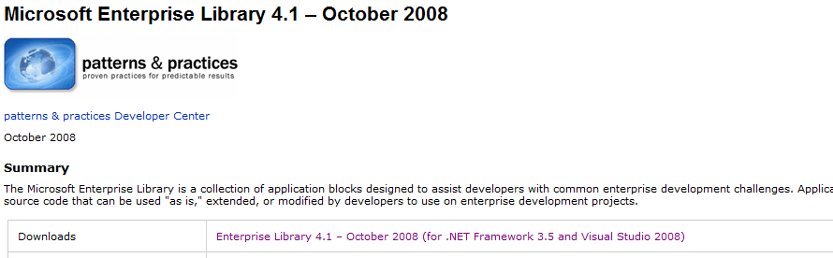
You can get EntLib 4.1 here
http://msdn.microsoft.com/en-us/library/dd203099.aspx

Slide 24
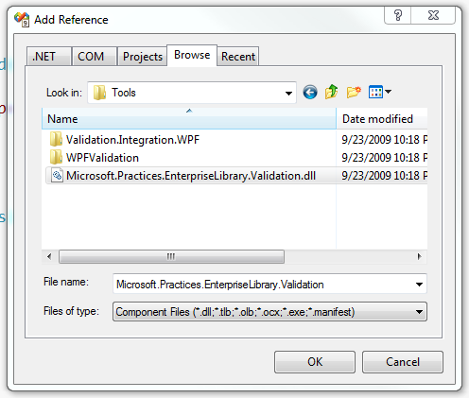
Add Reference

Slide 25
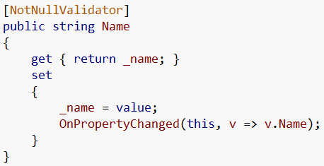
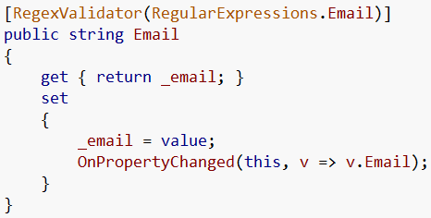
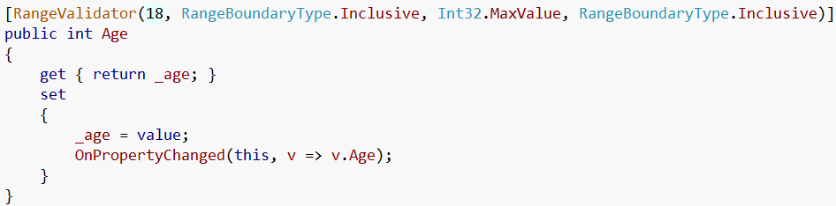
Use Validation Attributes

Slide 26
On Binding
Validates On Data Errors

Slide 27
Custom Markup Extensions

Slide 28
References
http://msdn.microsoft.com/en-us/library/dd203099.aspx

